Slide 1







Operations and Maintenance Benchmarking:
Three Simple Tools to Save Your Organization Money:
Culture, Methods, and Data
Justin Dodd, MS
Doctoral Research Assistant
University of North Carolina, Charlotte
Jake Smithwick, PhD, FMP, SFP
Professor
University of North Carolina, Charlotte

Slide 2





Simplar Institute
Group of researchers and educators
Integrated within the parties (clients/buyers and vendors)
Developed tools, methods, & training to enhance:
  Organizational Transformation
  Procurement & Sourcing
  Project & Risk Management
  Operational Efficiency
  Human Dimensions
  Performance Measurements
  Benchmarking & Workforce
  Facility Management Professional Training

Slide 3































Slide 4
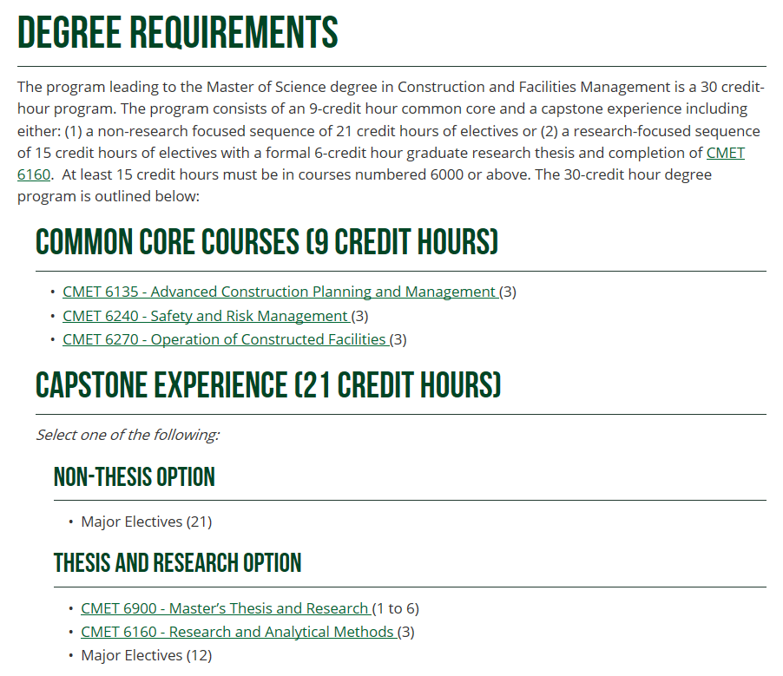
University of North Carolina at Charlotte
Master of Science in Construction/Facilities Management

Slide 5
Tool 1: Develop your benchmarking culture

Slide 6

Benchmarking Culture & Competitive History
Where did benchmarking come from?
Idea rooted in competitive history
Professional Sports
Notes:
add bullets

Slide 7

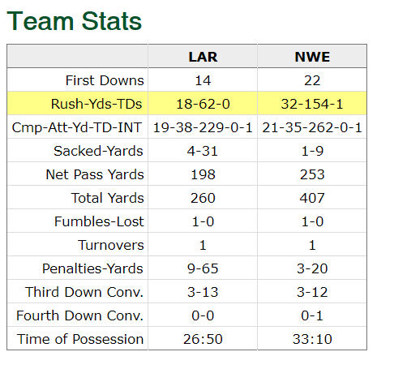
Benchmarking Culture & Competitive History
Notes:
show some actual results of a player

Slide 8
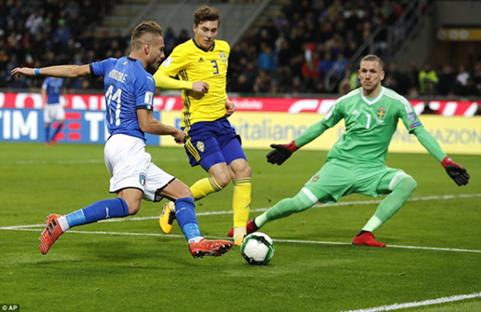

Benchmarking Culture & Competitive History
Competitive environment
Consensus metrics
Consensus goals – continual improvement
Sharing of information
Transparency in performance
Stakeholder involvement:
  Athletes
  Coaches
  Support Personnel
  Fans
TEAMWORK!

Slide 9

The Rise of Business Benchmarking
Robert C. Camp – Xerox – 1980s
Part of D.M.A.I.C Process – Lean Logistics movement
Became a readily embraced and popular business technique

Slide 10

Business Benchmarking
Auto Manufacturing Benchmarking
  “Best-in-class” became a widely recognized term

Slide 11
Business Benchmarking: Definition
“The search for industry best practices that lead to superior performance” ~ Robert Camp
Best Practice – what gets the job done

Slide 12
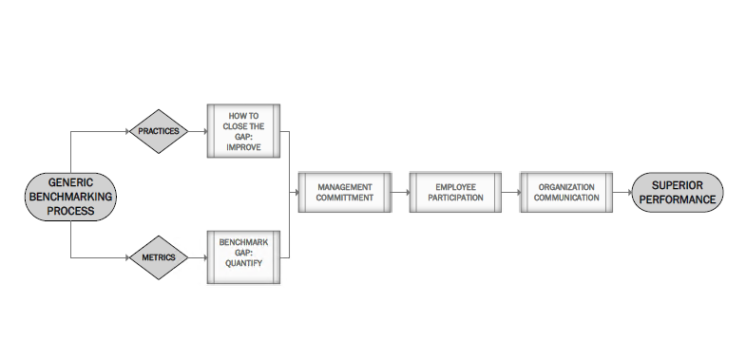
Benchmarking Process

Slide 13
Types of benchmarks
Types of Benchmarks:
  Internal
    Intra-organizational
    Sub-units vs. other sub-units
  Competitive
    Inter-organizational
  Generic
    Across industries

Slide 14
Benchmarking Methodology
How we go about benchmarking
Define what to benchmark
Form a benchmarking team
Identify benchmarking partners
Collect and analyze benchmarking information
Take Action
A continual process…there is always room for improvement!
Repeat Steps 1-5 for continual improvement

Slide 15
Tool 2: Follow a Benchmarking Model

Slide 16
1. What to Benchmark

Slide 17
What are we measuring?
Metrics
“85% of work orders completed on time”
Practices
“We actively use a green recycling program.”

Slide 18
Facility O & M: KPIs & Benchmarks
Metrics
Most Common Data Types Include:
Space
Occupancy
Staffing
Operating Costs
  Maintenance
  Janitorial
  Utility
  Security
Sustainability
Energy Management & Consumption
Occupant Satisfaction
Metrics correspond to fundamental Facility services or how we play the game
Measure how building services perform

Slide 19

Facility O & M: KPIs & Benchmarks
TOP Five Maintenance KPIs
Percentage of Work Orders closed on time
Preventative maintenance backlog
Time to respond to work requests
Number of service complaints
Time to repair work requests
Some metrics are more strategic than others

Slide 20
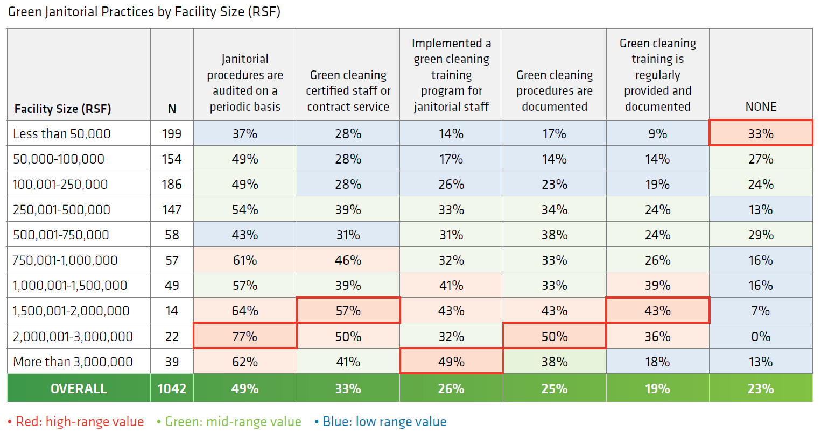
Green Janitorial Practices
About 77% of FMs use at least ONE green janitorial practice
Larger sites tend to use practices more often
Auditing was the most commonly used green practice
About ¼ of FMs
don’t use any
green practice

Slide 21
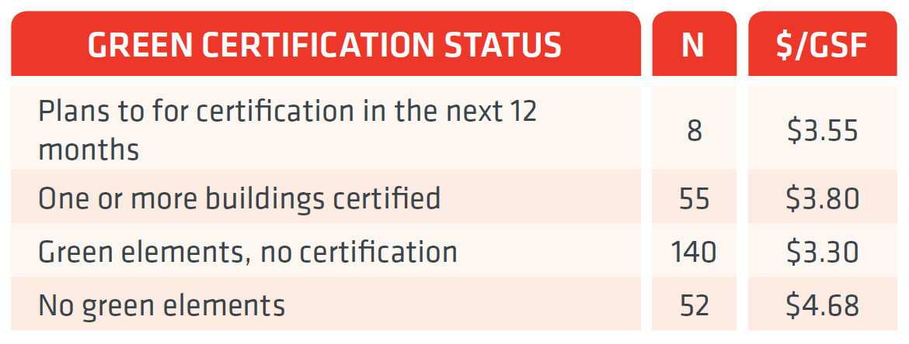
Utility Costs of Green Certification
So, green certification may save money
Get the full O&M report here: http://bit.ly/omresearch

Slide 22
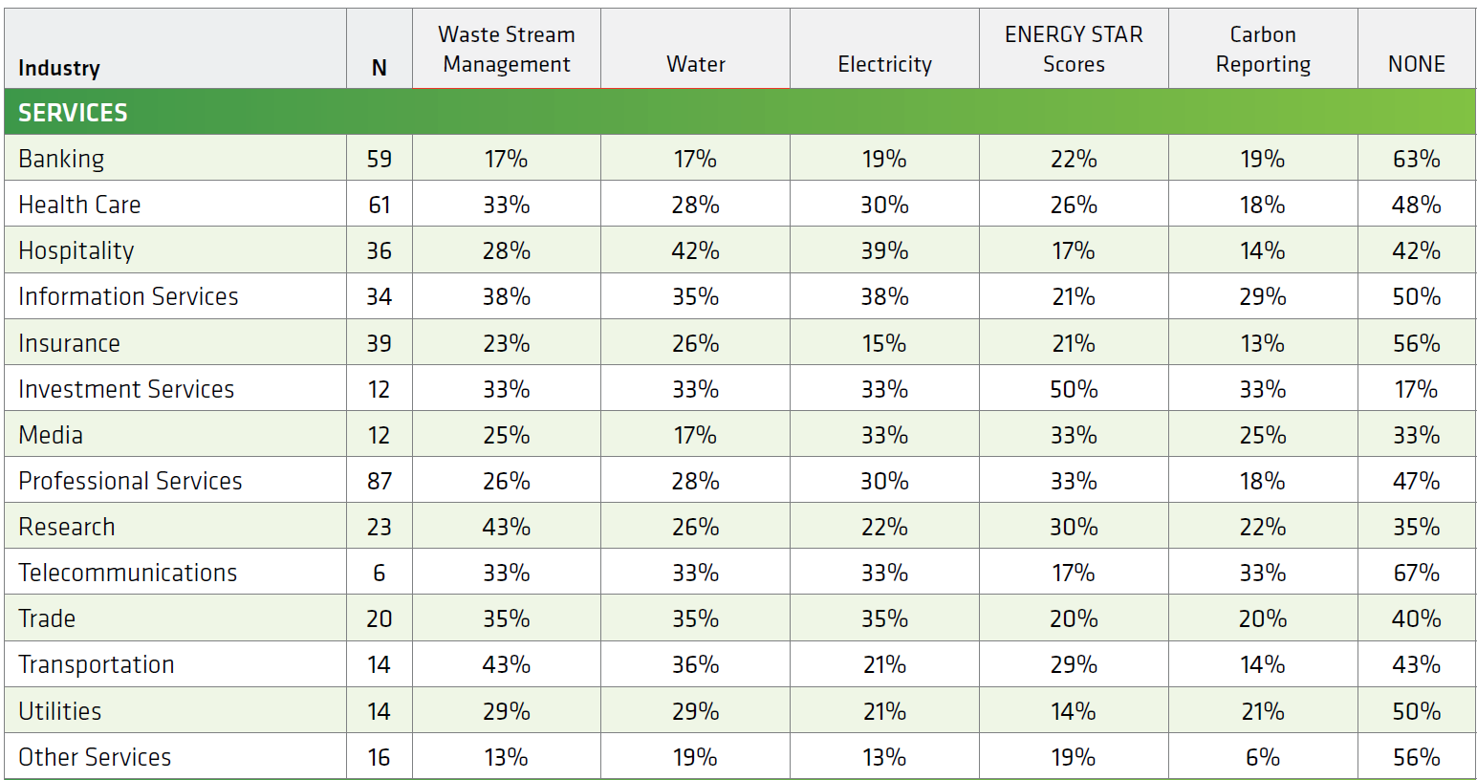
Legislative Mandates
Again, larger sites tend to use practices more often
Manufacturing has more mandates than other industry sectors
Waste Stream Management was the most common mandate
About 45% of FMs
have at least
one mandate

Slide 23
2. Form a Benchmarking Team

Slide 24

Facility Benchmarking Teams
How do we find the people?
Recruit a representative team
  All Levels and educational backgrounds
    Facility Manager
    Upper level management
    IT (Data Analyst)
    Staff managers
    Technicians
    Janitors
Champions
Notes:
3-4 slides
all levels & all educational levels
questions to answer:
how do we find the people
regular meetings & sample agenda [5 bullets]
how do they implement the plan?

Slide 25
Facility Benchmarking Teams
When do we meet and what do we do?
Regular meetings
Foster your Champions
Have an agenda
Benchmarking Team Agenda
Review of initiatives
Departmental Progress Reports/Updates
Review of audits of collection process
Review of data
Discussion of upcoming events
Report on organizational benchmarking awareness
Setting of new goals
Notes:
3-4 slides
all levels & all educational levels
questions to answer:
how do we find the people
regular meetings & sample agenda [5 bullets]
how do they implement the plan?

Slide 26
Facility Benchmarking Teams
How do we implement the plan?
Have a written action plan
Corporate commitment to act upon the results
Follow a Benchmarking Model (Methodology)
Settle-in for a long and iterative process
Notes:
3-4 slides
all levels & all educational levels
questions to answer:
how do we find the people
regular meetings & sample agenda [5 bullets]
how do they implement the plan?

Slide 27
3. Identify Benchmarking Partners

Slide 28
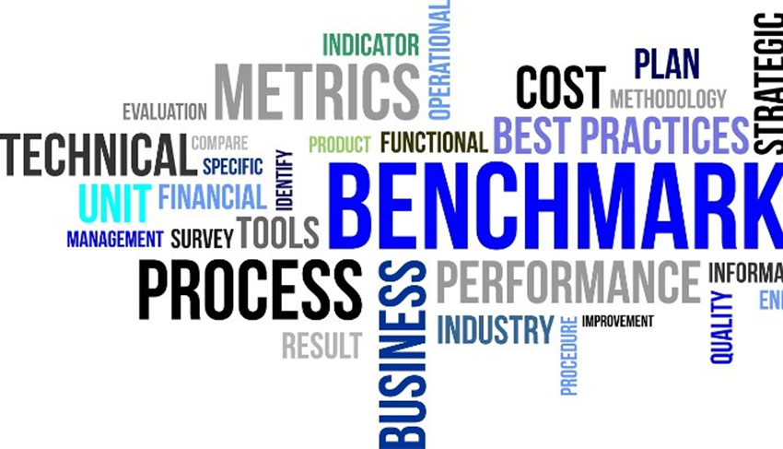
Benchmarking Partners and Networks:
A critical component of the benchmarking process

Slide 29

Benchmarking Partners
Broad definition – Persons or organizations who supply you with information related to your benchmark investigation
Partners can include:
Industry Associations
Database Developers (Sources of info)
Other units within an organization (Internal benchmarking)
Other organizations (Competitive Partnerships)
Notes:
add some animation
bigger text

Slide 30

Competitive Partnerships
Competitive Partnerships – Organizations working together
Encounter most organizational resistance, but can be the most rewarding partnerships
Unique insights into long-term benchmarking process
Examples of industries improved using competitive partnerships:
  Professional Sports
  Auto Manufacturing Industry
  Manufacturing & Logistics Industries
  Electric Utilities
  Transportation Infrastructure (DOTs)

Slide 31
Successful Competitive Partnerships
How do we go about developing a competitive partnership?
Components of Successful Competitive Partnerships (Organizational Partners)
Organizational commitment
Authority to make organizational changes
Identified Data sources
Non-disclosure agreements (legal contracts)
Time commitment
Identified benchmarking staff & team
Interviews, meetings, site visits
Agreed upon benchmarking units (Facility, Department, System, etc)
Defined set of metrics

Slide 32


Benchmarking Network
Sum total of contacts, partnerships, and data
Components of a benchmarking network
  Associations
  Databases
  Published Reports
  Organizations
  FM Industries
  Partners

Slide 33
4. Collect and Analyze Benchmarking Data

Slide 34

COLLECTING DATA
Check & Recheck
Your benchmarking is only as good as your metrics
Train your team on collection
Double-Check:
  Floor/Area Calculations & Definitions
  RSF, GSF, Plannable Area
Use Automated data collection as much as possible
Have set intervals for collecting the data
Use Checklists
Audit the collection process

Slide 35

ANALYZING DATA
Comparing Metrics
How are we performing?
“Apples to Apples”
Compare data from similar facilities & industry
Means, Medians, Quartiles
Comparing Practices
Who is doing what?
“Apples to Oranges”
Practices can be adopted from any industry
Who or % using
Linking Metrics to Practices
What are the best-in-class doing?
Specific Database queries
Direct analysis of raw data
“Apples to Apples”
Ex. 68% of FM Staff Energy trainings result in decreased consumption
Technical Reports & Databases
Reports, Inquiries
Notes:
add some animations
maybe??? split up
clarify metrics & practices column

Slide 36
5. Take Action

Slide 37

Taking Action
THE MOST IMPORTANT STEP!!
Implement and Control
  Implement new practices
  Measure
  Regulate & Audit
  Develop into your own best practice
Repeat Process
Be Patient
https://www.bing.com/images/search?view=detailV2&id=FBCF2A66A8282E6B14AD36994FCF2E44F5B336A1&thid=OIP.07_RRjTdvMqffvfQqlcM8gHaDt&mediaurl=https%3A%2F%2Faz616578.vo.msecnd.net%2Ffiles%2F2016%2F12%2F29%2F6361858713207237582018447007_action.jpg&exph=1000&expw=2000&q=picture+of+action&selectedindex=2&cbir=sbi&ajaxhist=0&vt=0&eim=1,2,6
Notes:
animation

Slide 38


Not Taking Action
Window Shopping
Headed for a fall
Notes:
animation

Slide 39
Key Lessons Learned for Benchmarking
Data collection vs Benchmarking
  Raw numbers are not sufficient, information has context
Multi-tiered data collection for validity and scale
  General, simple, fast
  Detailed, nuanced, supported
  Hands-on and individual
  Use the right research tools for the job
Consider the Benchmarking End User – How easy can you make it to use?

Slide 40
Take-Aways
Develop your benchmarking culture
Follow a benchmarking methodology
  Benchmarking is art and science, practices and metrics
Data is not easy to collect… but it is a powerful tool to make change!
  It takes time, repetition, and patience

Slide 41
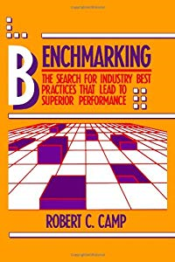

Recommended Readings
Camp, R. C. (1989). Benchmarking: the search for industry best practices that lead to superior performance. Milwaukee, WI: White Plains, N.Y: Quality Press ; Quality Resources.
IFMA (N.D.). Benchmarking for Facility Professionals. White Paper. https://foundation.ifma.org/docs/defaultsource/Whitepapers/benchmarking-for-facility-professionals-ifma-foundation-whitepaper-small.pdf?sfvrsn=4
Notes:
big pictures bigger

Slide 42
Questions / Comments?
Justin Dodd
jdodd@uncc.edu
Jake Smithwick
Jake.Smithwick@uncc.edu

